Slide 1
Set Questions:
Do you think slavery existed elsewhere in the world? (besides the 13 colonies?)
What motivated people who sold slaves?
Does slavery still exist today?

Slide 2
Origins of Slavery
Chapter 4 Section 3
Learning Target: I can describe the development and spread of slavery in Colonial America.

Slide 3
Key Terms
triangular trade – a three-way trade between the Americas, Europe, and Africa
racism – the belief that one race is superior or inferior to another
slave codes – strict laws that restricted the rights and activities of slaves

Slide 4
What is the definition of Slavery?
Slavery- forced work without compensation
Slaves were given food and shelter, but they were deprived of basic rights

Slide 5
When did Slavery begin?
Slavery has been common since ancient times

Slide 6
Where did most African Slaves come from?
West Africa

Slide 7
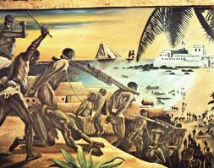
Beginning
African slavers capture people from other tribes
Forced march to the coast (up to 300 miles)
Trade with Europeans for guns and other goods

Slide 8
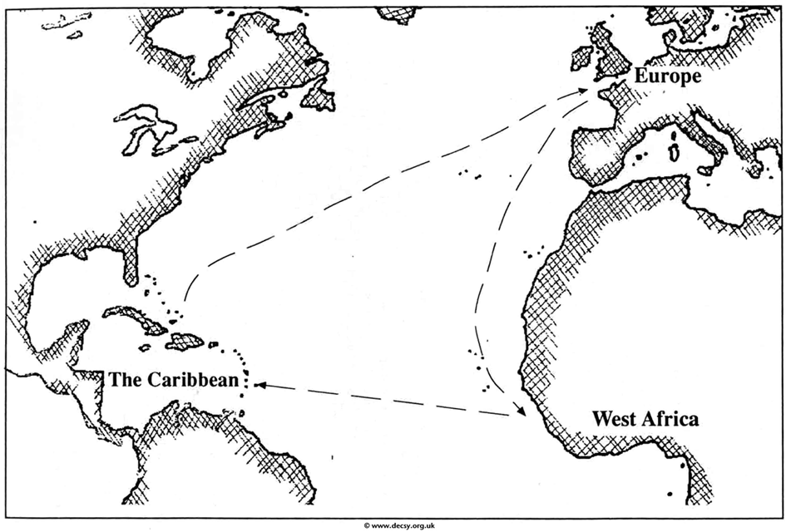
Triangular Trade

Slide 9
Triangular Trade
First Leg
Europeans would sail to West Africa and trade manufactured goods and guns for African slaves.
Second Leg
The traders would then sail to the America’s with their human cargo and trade the slaves for raw materials such as tobacco, lumber, and sugar
Third Leg
They would then take the tobacco, lumber and sugar to Europe for consumption/manufacturing
The process would then repeat

Slide 10
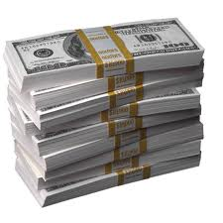
Triangular Trade
Although the triangular trade was illegal under the Navigation Acts, many New England and European merchants violated the rules because it made them wealthy.

Slide 11
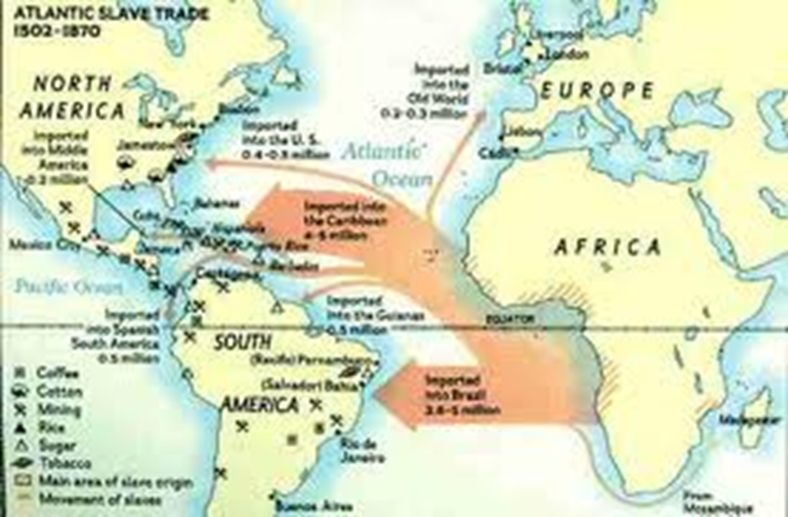
The Middle Passage
Middle Passage – a slave’s voyage from Africa to the Americas

Slide 12
The Middle Passage
Transported across the Atlantic Ocean in extremely cramped quarters

Slide 13
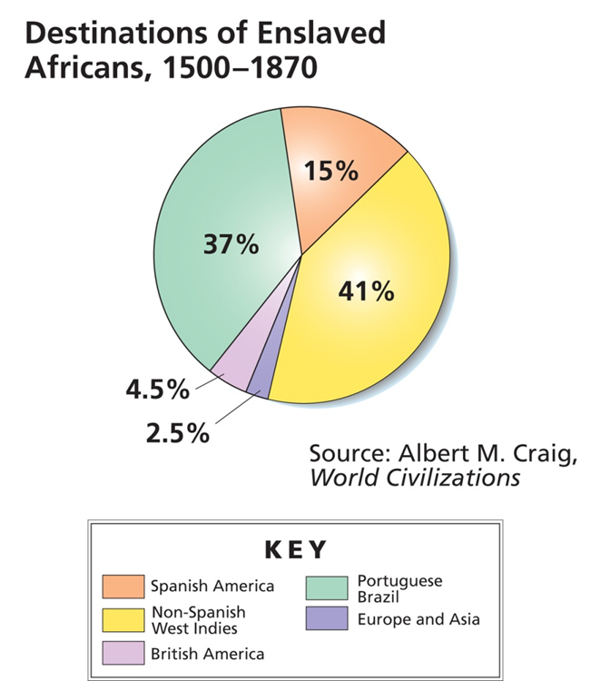
Dispersal
Not all slaves went to the 13 colonies
Most go to Brazil or the Caribbean
Only 4.5% come to what is now the United States

Slide 14
Slavery in the Colonies
The first enslaved Africans in the colonies may have been treated as servants, and some eventually were freed.
But as the need for cheap labor grew, colonies made slavery permanent.
Some colonies tried to ban slavery, but it eventually became legal in all the colonies.

Slide 15
Slavery in the Colonies
Why did slavery take root in the colonies?
The plantation system led the southern economy to depend on slavery.
Planters preferred slaves because while indentured servants were freed after their terms were over, slaves were slaves for life.

Slide 16
Slavery in the Colonies
In the North
Only 10 percent of the enslaved population lived north of Maryland.
Northern slaves worked as blacksmiths, house servants, or farm laborers.
Over time, they might buy their freedom.
In the South
On rice plantations in South Carolina, slaves kept the customs of West Africa.
Plantations used slave labor for harvesting cash crops like tobacco and cotton.

Slide 17
Who profited from Slavery?
African Slave Traders exchanged captured Slaves for weapons and other goods
Slave Ship Owners earned a profit from shipping the slaves
Plantation owners benefited from free labor

Slide 18
Influence
African culture influenced American culture
Crafts workers in cities used African styles of quilts, furniture, and other objects.
African drums and banjos became part of American music.
African folk tales became part of American culture.

Slide 19
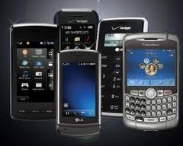
Does slavery still exist?

Slide 21
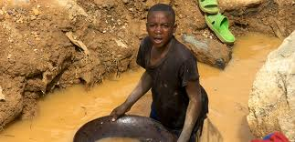
Does Slavery Exist Now?
75% of cell phones and other electronic devices contain “conflict minerals”
Mined by forced laborer for the profit of warring militias

Slide 22
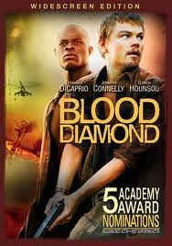

Slide 23
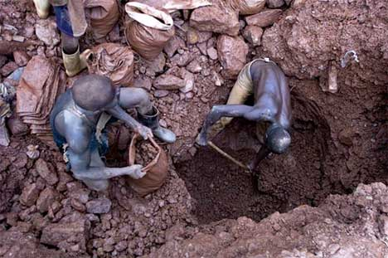

Slide 24
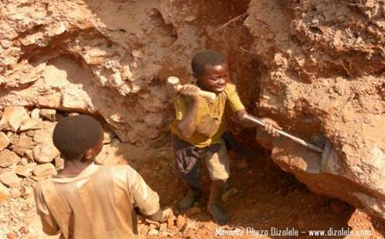

Slide 25
Conflict minerals
Conflict minerals are minerals mined in conditions of armed conflict and human rights abuses, notably in the eastern provinces of the Democratic Republic of the Congo, by the Congolese National Army, and various armed rebel groups, including the Democratic Forces for the Liberation of Rwanda (FDLR) and the National Congress for the Defense of the People (CNDP), a proxy Rwandan militia group.

Slide 26
Conflict Mineral
Tantalite - the metal ore from which the element tantalum is extracted. Tantalum is used primarily for the production of capacitors, particularly for applications requiring high performance, a small compact format and high reliability, ranging widely from hearing aids and pacemakers, to airbags, GPS, ignition systems and anti-lock braking systems in automobiles, through to laptop computers, mobile phones, video game consoles, video cameras and digital cameras.[5] In its carbide form, tantalum possesses significant hardness and wear resistance properties. As a result, it is used in jet engine/turbine blades, drill bits, end mills and other tools.

Slide 27
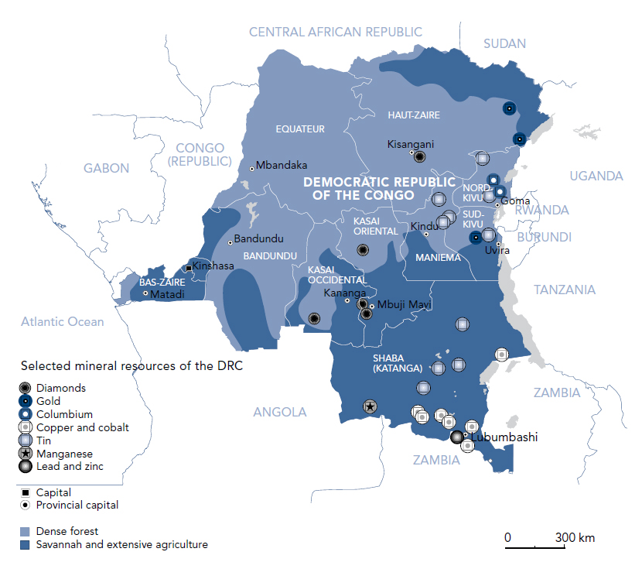

Slide 29
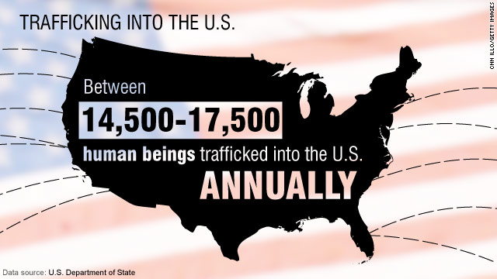

Slide 31
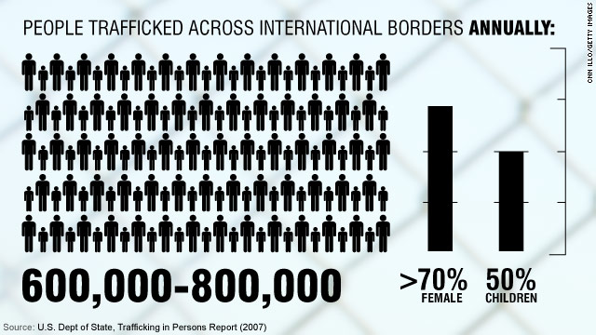

Slide 32
When is Slavery banned?
Rhode Island- temporarily bans Slavery in 1652
Pennsylvania- restricts Slavery in the 1780’s
England led the world in the fight against Slavery (1833)
13th Amendment bans Slavery in America (1864)
1981 Mauritania abolishes slavery (last country)

Slide 33
Closing Questions:
What is one fact/thing you found interesting about the topic we covered today?
What is one fact/thing you would like to know more about?
What can you do to help stop slavery in the world?

